Slide 1
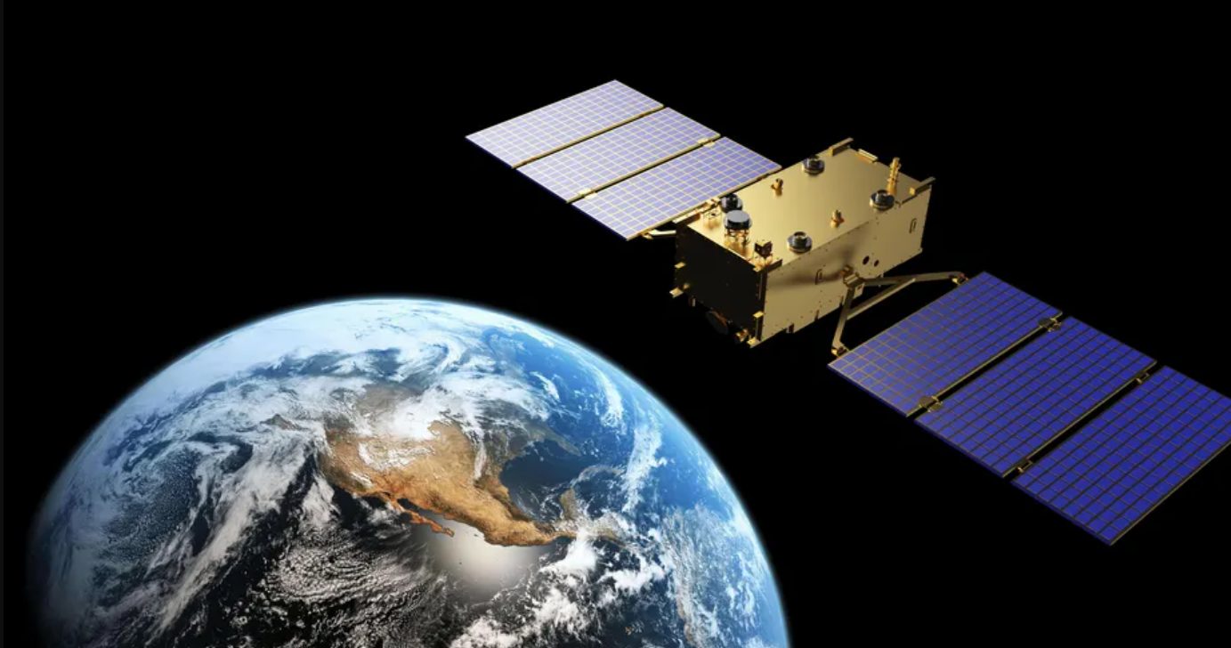
Data Science Capstone project
Mordechy Kot
Aug. 10th, 2021

Slide 2
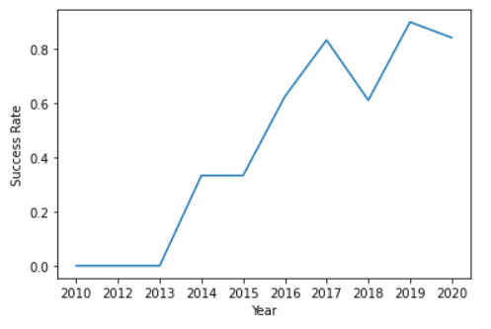
(Cover Page)
Analysis of SpaceX technologies using publicaly available data
Intro: SpaceX can provide commercial space transportation at a fraction of the price of other providers because of their reusable booster technology, which reduces their costs considerably.
Results: Analysis reveals SpaceX typically has failures with new technologies and mission types, which are “ironed out” later on. Their success rate climbes as they gain experience.
Despite several past failures, they now have good success rates with tried-and-tested tech:
Midweight payloads
Home-based launches from Kennedy space center.
Low- and medium-altitude circular earth orbit.
They are still struggling with relatively new endeavors:
High energy orbits such as PO and GTO.
High Payloads
New booster versions
Remote base launches.
It is in those fields that conventional (non-reusable) rockets can still, for now, be competitive in the space transportation market.
It is otherwise expected that SpaceX will be able to drop its prices even lower, and venture into new space-transportation products.
Aim: to use publically available data published by SpaceX, in order to enable our company (SpaceY) to bid against them in the space transportation market.
Method: A machine learning model was constructed, giving our company the ability to predict with high accuracy

Slide 3
Table of Contents
Executive Summary 4
Introduction 5
Methodology 6
Data Collection 7
SpaceX API 8
Web Scraping 9
Data Wrangling 10
Exploratory Data Analysis with Visualization 11
Flight Number vs. Launch Site 12
Payload vs. Launch Site 13
Success Rate vs. Orbit Type 14
Flight Number vs. Orbit Type 14
Payload vs. Orbit Type 15
Launch Success Yearly Trend 16
Exploratory Data Analysis with SQL 17
All Launch-site Names 18
Launch Site Names Beginning with CCA 19
Total Payload Mass 20
Average Payload Mass for F9 v1.1 21
First Successful Ground Landing Date 22
Successful drone Ship Landing w/ Payload
Between 4000 and 6000kg 23
Total Number of Successful and Failure
Mission Outcomes 24
Boosters which carried maximum payload 25
2015 Launch Records 26
Rank Success Count Between Dates 27
Interactive Map with Folium 28
F9 Launch Locations 29
Mission Results per Launch-Site 30
Analysis of Launch Sites’ Proximities 31
Dashboard with Plotly Dash 33
Distribution of Successful Launchs Between
Launch Sites 34
Site with Highest Success Rate 35
Payload Success Plots 36
Predictive Analysis (Classification) 37
Method 38
Classification Accuracy – Small Test Size 39
Classification Accuracy – Large Test Size 40
Conclusion 41

Slide 4
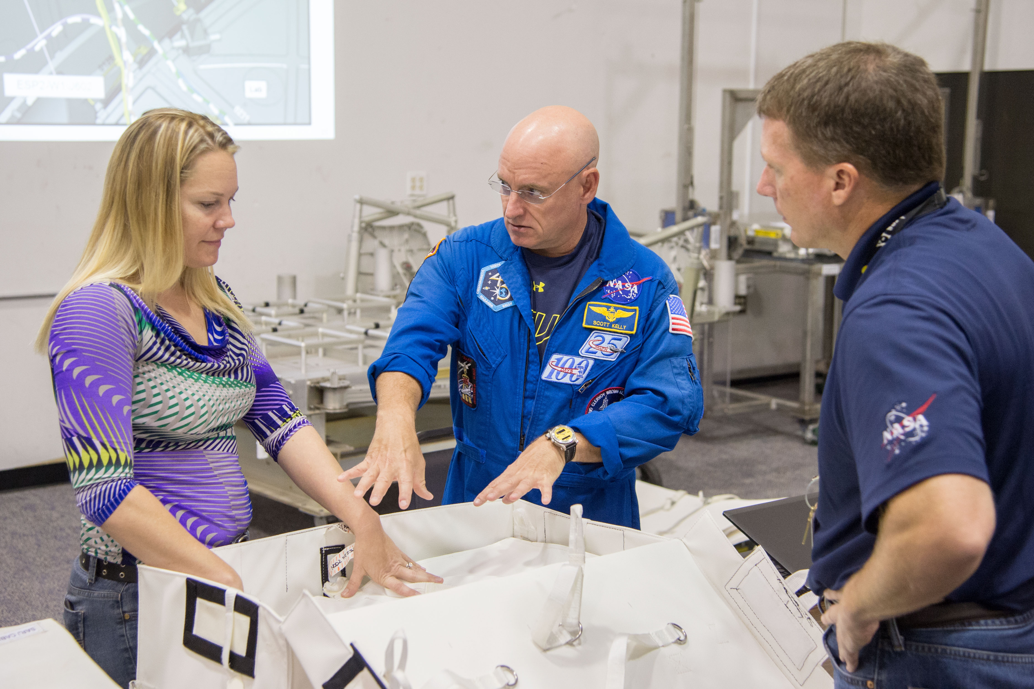

Executive Summary
Object: To gain insight into Space-X technologies and strategies.
Method: We harvest publicly available mission data published by Space-X. We:
Give a thorough visualized summary of their past strategies, and
Fit the data to several machine learning models.
Results:
SpaceX has good success rates with tried-and-tested tech:
Midweight payloads
Home-based launches from Kennedy space center.
Low- and medium-altitude circular earth orbit.
They are still struggling with relatively new endeavors:
High energy orbits such as PO and GTO.
High Payloads
New booster versions
Remote base launches.
It is in those fields that conventional (non-reusable) rockets can still, for now, be competitive in the space transportation market.
It is otherwise expected that SpaceX will be able to drop its prices even lower, and venture into new space-transportation products.

Slide 5
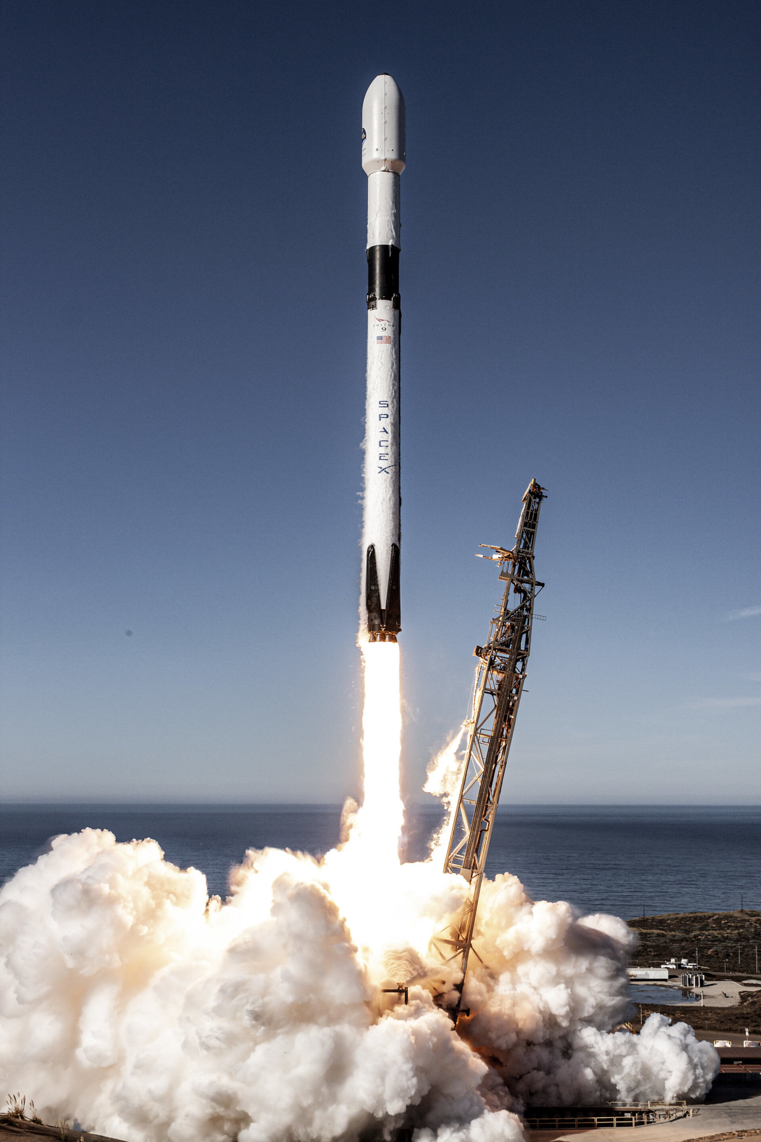
Introduction
Space Exploration Technologies Corp. (SpaceX) is an American aerospace manufacturer, space transportation services and communications company headquartered in Hawthorne, California. SpaceX manufactures the Falcon 9 and Falcon Heavy launch vehicles, several rocket engines, Dragon cargo, crew spacecraft and Starlink communications satellites.
The object of this review is to give insight that will enable our company, SpaceY, to gain a foothold in the space transportation market.
SpaceX advertises Falcon 9 rocket launches on its website with a cost of 62 million dollars; other providers cost upward of 165 million dollars each. much of the savings is because SpaceX can reuse the first stage
Therefore if we can determine if the first stage will land, we can determine the cost of a launch. This information can be used to bid agains SpaceX for a rocket launch.
Falcon 9 Rocket carrying the Copernicus Sentinel-6 satellite.

Slide 6
Methodology
Data about SpaceX launches is collected from SpaceX publication
The launch data is explored visually, primarily through scatter plots, to reveal the links between different variables and give a coarse understanding of the data.
Launch success rates are visualized on a map, and the launch sites and their proximities are analyzed.
A machine learning model is fitted to the data, which will enable us to evaluate and predict the success rate of various SpaceX products.

Slide 7
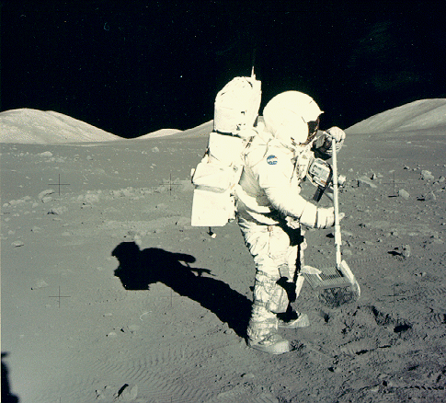
Data collection
Astronaut Jack Schmitt collecting rocks during Apollo 17

Slide 8
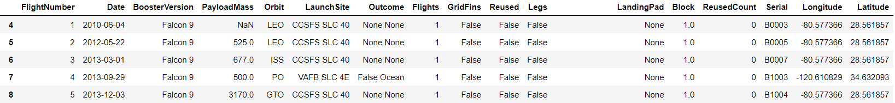
Data Collection – SpaceX API
Flow of API call
Request Past Launches Information
import requests
spacex_url=https://api.spacexdata.com/v4/launches/past
response = requests.get(spacex_url)
Data about SpaceX missions was gathered using the publicly available SpaceX API, containing all previous mission details as a JSON response.
The response was edited to form a Pandas dataframe.
Use json_normalize meethod to convert the json result into a dataframe
data_json = response.json()
data = pd.json_normalize(data_json)
Separate JSON into data columns
getBoosterVersion(data)
getLaunchSite(data)
getPayloadData(data)
getCoreData(data)
Pandas Dataframe Format:
Generate pandas dataframe
data = pd.DataFrame.from_dict(launch_dict)
GitHub link:
https://github.com/Trimorphous/IBM_Data_Sci_Final/blob/d3ae025f677abee04e433bd2ec3701aa2fda2d67/W1.1%20Data%20Collection%20API.ipynb

Slide 9
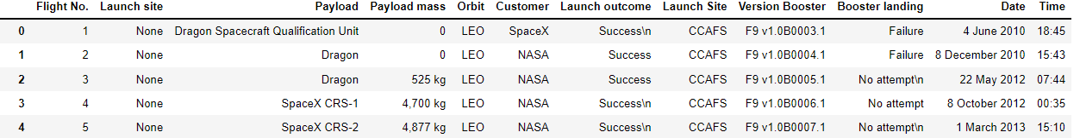
Data Collection – Web Scraping
Flow of Webscraping
Obtain HTTP response of Wiki Page
import requests
from bs4 import BeautifulSoup
static_url = "https://en.wikipedia.org/w/index.php?title=List_of_Falcon_9_and_Falcon_Heavy_launches&oldid=1027686922"
response = requests.get(static_url)
The data was obtained by means of webscraping Wikipedia page “List of Falcon 9 and Falcon Heavy launches”.
The Wikipedia tables reference a veriaty of sources, the top of which are:
"Launch Log". Spaceflight Now. 1 February 2016
"SpaceX Launch Manifest". SpaceX.
The latter being an official SpaceX source.
Convert to BeautifulSoup Object
soup = BeautifulSoup(response.text)
Extract Tables from ‘Soup’ Object
html_tables = soup.find_all('table')
Scan through tables, and break apart rows into dictionaries.
Pandas Dataframe Format:
Combine dictionaries into a pandas dataframe
GitHub link:
https://github.com/Trimorphous/IBM_Data_Sci_Final/blob/d3ae025f677abee04e433bd2ec3701aa2fda2d67/W1.2%20Webscraping.ipynb

Slide 10
Data Wrangling
Import data
Counted number of missions per launch site
Counted number of missions per Orbit
Counted number of missions per landing outcome
The most important change here is the transition to working with a “landing class” category, where
Class = 1 for successful landings, and
Class = 0 for unsuccessful landings.
This is done to enable later training on numerical values. It also makes calculating the success rate simpler, as this is simply the average of the class.
The total success rate on all Falcon 9 missions is 67%.
Classified all landing outcomes to “successful” and “unsuccessful”
Created a “class” column
Where:
Class = 1 for successful landings, and
Class = 0 for unsuccessful landings.
GitHub link:
https://github.com/Trimorphous/IBM_Data_Sci_Final/blob/bbbb8b98a7ef92d7106e5ad79867954bae3f10b1/W1.3%20Data%20Wrangling%20EDA.ipynb

Slide 11
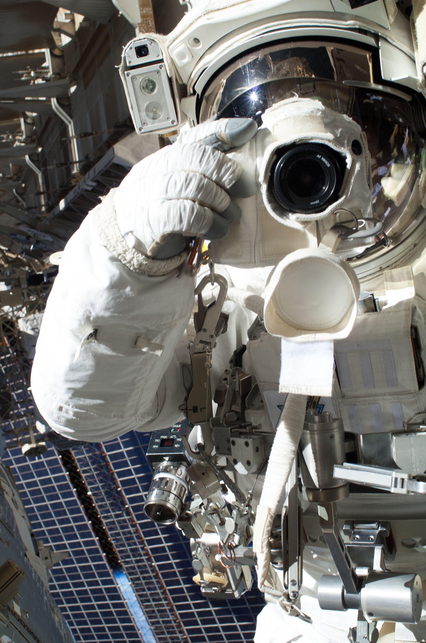
EDA with Visualization
Git Link: https://github.com/Trimorphous/IBM_Data_Sci_Final/blob/26c7e0a7672edb1d9b1911dc8850fd40162c263d/W2.2%20EDA%20Exploratory%20Data%20Analysis%20with%20Visualization.ipynb

Slide 12
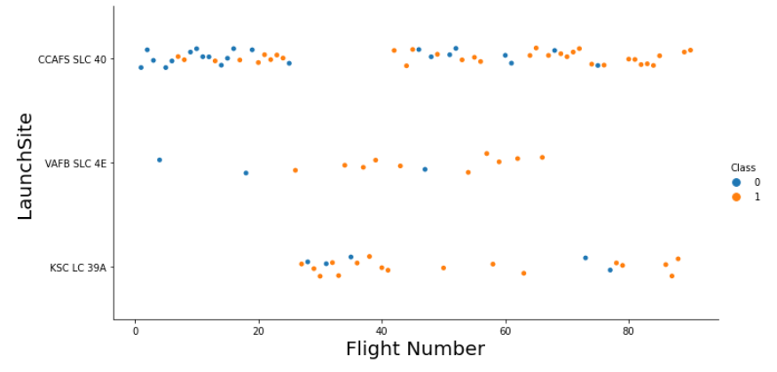
Flight Number vs. Launch-Site
CCAFS = Cape Canaveral Air Force Station
VAFB = Vandenberg Air Force Base
KSC = Kennedy Space Center
The launch-site usage can be roughly divided into 3 periods:
Testing begins, mostly at Cape Canaveral
Transferring to Kennedy for a short period
Moving back to mostly Cape Canaveral
Failure
Success
Vandenberg Air Force Base sees intermittent use throughout the Falcon 9 testing.
Git Link: https://github.com/Trimorphous/IBM_Data_Sci_Final/blob/26c7e0a7672edb1d9b1911dc8850fd40162c263d/W2.2%20EDA%20Exploratory%20Data%20Analysis%20with%20Visualization.ipynb

Slide 13
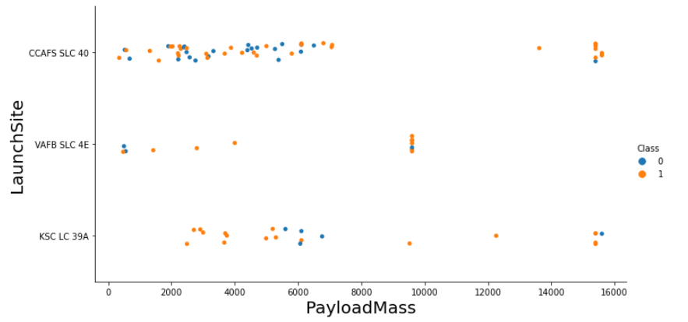
Payload vs. Launch-Site
CCAFS = Cape Canaveral Air Force Station
VAFB = Vandenberg Air Force Base
KSC = Kennedy Space Center
Low payload missions take place at all bases.
Intermediate payload missions take place mostly at Vandenberg AFB (West coast).
High payload missions only happen at CCAFS and KSC (East coast)
Low Payload
Intermediate Payload
High Payload
Failure
Success
Most likely, west-coast launches go into retrograde orbit, and east-coast launches go into prograde orbit.
Since retrograde orbits require more fuel, they exclude high-payload missions. Therefore, we don’t see high-payload missions from the west coast.
Git Link: https://github.com/Trimorphous/IBM_Data_Sci_Final/blob/26c7e0a7672edb1d9b1911dc8850fd40162c263d/W2.2%20EDA%20Exploratory%20Data%20Analysis%20with%20Visualization.ipynb

Slide 14
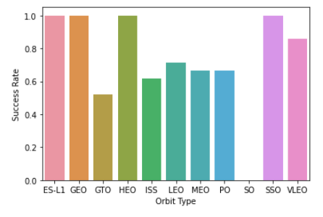
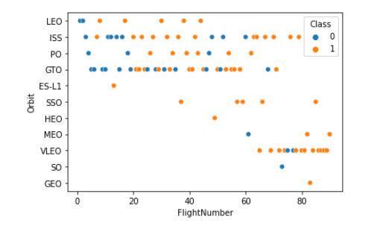
Success Rate vs. Orbit Type
LEO: Low Earth orbit
VLEO: Very Low Earth Orbits
GTO Geostationary transfer orbit.
SSO (or SO): It is a Sun-synchronous orbit
ES-L1 Lagrange point 1
HEO A highly elliptical orbit.
ISS International Space Satation7]
MEO Medium Earth Orbit[8]
HEO Highly Elliptical Orbit
GEO geosynchronous orbit
PO Polar Orbit
Flight Number vs. Orbit Type
The orbit types that have the lowest success rates are typically the first ones that SpaceX attempted – LEO, ISS, PO and GTO. This is evident by their low flight-numbers.
Later orbits attempted likely draw from the experience of these first missions and therefore have higher success rates.
Git Link: https://github.com/Trimorphous/IBM_Data_Sci_Final/blob/26c7e0a7672edb1d9b1911dc8850fd40162c263d/W2.2%20EDA%20Exploratory%20Data%20Analysis%20with%20Visualization.ipynb

Slide 15
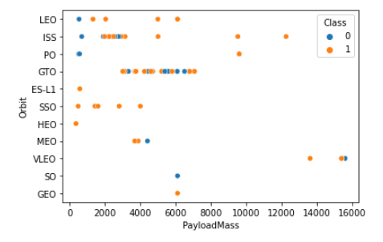
Payload vs. Orbit Type
Low-payload missions happen for almost all orbits, but high-payload missions are limited to low orbits, since they require more fuel and cannot go as high.
We therefore see high-payload missions only for ISS and VLEO orbits, both very low.
Git Link: https://github.com/Trimorphous/IBM_Data_Sci_Final/blob/26c7e0a7672edb1d9b1911dc8850fd40162c263d/W2.2%20EDA%20Exploratory%20Data%20Analysis%20with%20Visualization.ipynb

Slide 16
Launch Success Yearly Trend
As we have already observed in the “Flight Number vs. Orbit type” graph, the success rate is very highly correlted to the year of launch.
SpaceX clearly learn from their mistakes and apply the lessons of one type of mission, to all other types of missions.
Git Link: https://github.com/Trimorphous/IBM_Data_Sci_Final/blob/26c7e0a7672edb1d9b1911dc8850fd40162c263d/W2.2%20EDA%20Exploratory%20Data%20Analysis%20with%20Visualization.ipynb

Slide 17
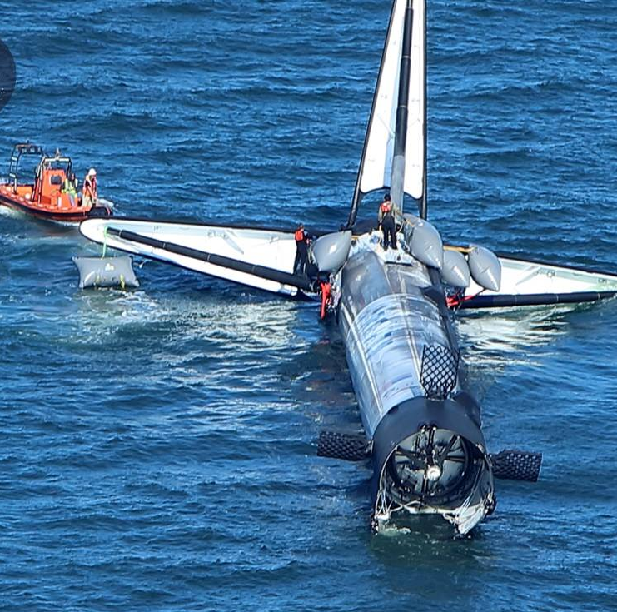
EDA with SQL
Git Link: https://github.com/Trimorphous/IBM_Data_Sci_Final/blob/9e11b5333d28ba914475c6c421030861ebf28915/W2.1%20EDA%20exploratory%20data%20analysis%20with%20SQL.ipynb
The Falcon 9 which launched Dragon CRS-16 to the ISS for NASA, floating offshore of Port Canaveral about 24 hours later.

Slide 18
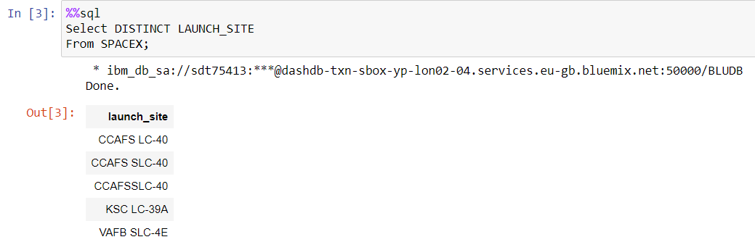
All Launch-Site Names
The data contains these unique site names:
Cape Canaveral Air Force Based
Kennedy Space Center
Vandenberg Air Force Base
Git Link: https://github.com/Trimorphous/IBM_Data_Sci_Final/blob/9e11b5333d28ba914475c6c421030861ebf28915/W2.1%20EDA%20exploratory%20data%20analysis%20with%20SQL.ipynb

Slide 19
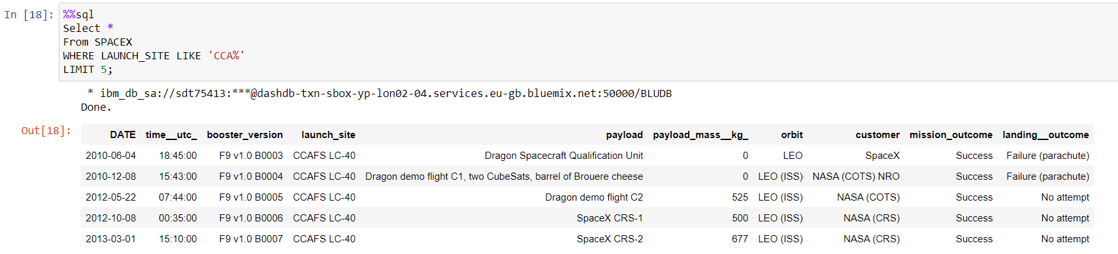
Launch-Site Names Beginning with `CCA`
The sites beginning with CCA are located at Cape Canaveral.
Below is an example of the first 5 records of Cape Canaveral launches:
Git Link: https://github.com/Trimorphous/IBM_Data_Sci_Final/blob/9e11b5333d28ba914475c6c421030861ebf28915/W2.1%20EDA%20exploratory%20data%20analysis%20with%20SQL.ipynb

Slide 20
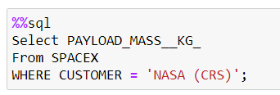
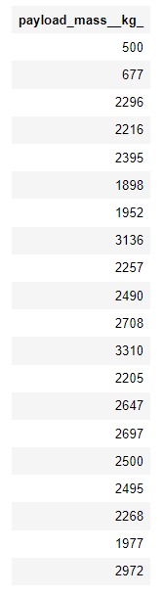
Total Payload Mass
The list of payload masses for NASA CRS boosters ranges from 500 to 3136kg.
These are considered very low payloads.
Therefore, SpaceX has a high motivation to develop boosters that can carry higher loads, up to 16000kg
Git Link: https://github.com/Trimorphous/IBM_Data_Sci_Final/blob/9e11b5333d28ba914475c6c421030861ebf28915/W2.1%20EDA%20exploratory%20data%20analysis%20with%20SQL.ipynb

Slide 21
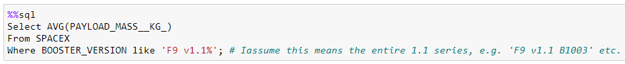
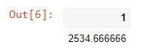
Average Payload Mass for F9 v1.1
The Average payload mass of the F9 v1.1 is 2535kg.
This is comparable to the NASA CRS booster.
SpaceX is likely to push the F9 to higher loads, or develop a heavier booster.
Git Link: https://github.com/Trimorphous/IBM_Data_Sci_Final/blob/9e11b5333d28ba914475c6c421030861ebf28915/W2.1%20EDA%20exploratory%20data%20analysis%20with%20SQL.ipynb

Slide 22
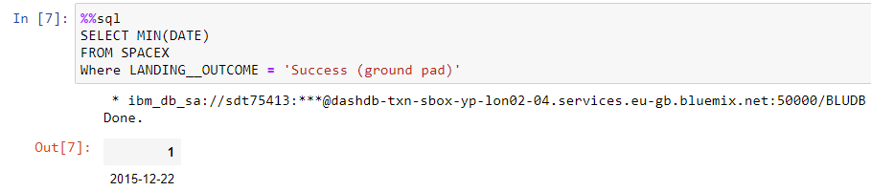
First Successful Ground Landing Date
The first successful ground-pad landing happened on 2015-12-22
Git Link: https://github.com/Trimorphous/IBM_Data_Sci_Final/blob/9e11b5333d28ba914475c6c421030861ebf28915/W2.1%20EDA%20exploratory%20data%20analysis%20with%20SQL.ipynb

Slide 23
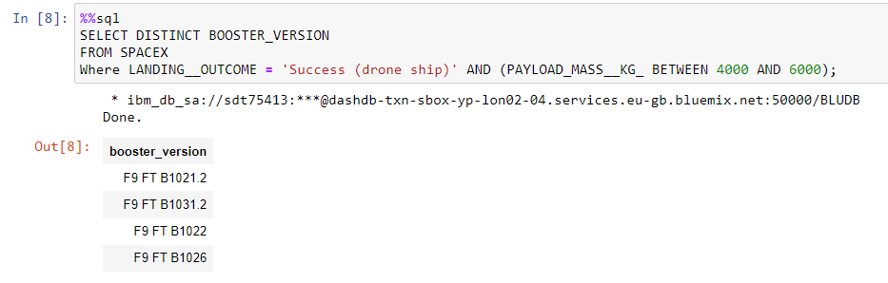
Successful Drone Ship Landing with Payload Between 4000 and 6000
The mid-weight, drone-ship missions are dominated by variants of the F9 FT booster.
The F9 FT booster has the potential to revolutionize mid-weight missions by introducing reusability to that corner of the market.
Git Link: https://github.com/Trimorphous/IBM_Data_Sci_Final/blob/9e11b5333d28ba914475c6c421030861ebf28915/W2.1%20EDA%20exploratory%20data%20analysis%20with%20SQL.ipynb

Slide 24
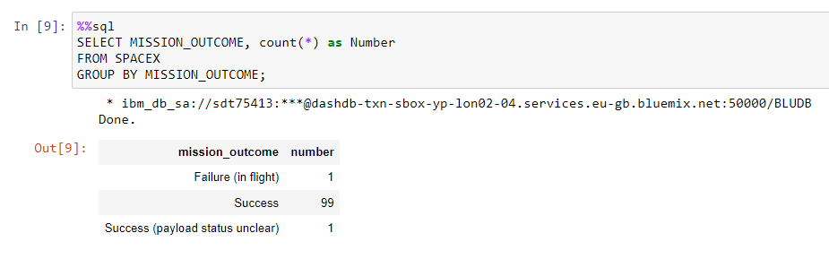
Total Number of Successful and Failure Mission Outcomes
Out of 101 missions, SpaceX list only 1 failure.
This probably means that SpaceX considers a success any mission where the payload was delivered to orbit, even if the rocket subsequently crashed.
Git Link: https://github.com/Trimorphous/IBM_Data_Sci_Final/blob/9e11b5333d28ba914475c6c421030861ebf28915/W2.1%20EDA%20exploratory%20data%20analysis%20with%20SQL.ipynb

Slide 25
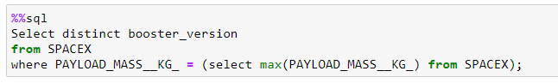
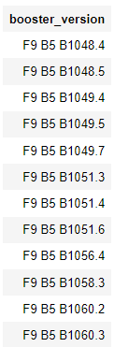
Boosters which Carried Maximum Payload
The Maximum payloads were carried by variants of the F9 B5 booster.
This will most likely be SpaceX’s heavy-weight carrier.
Git Link: https://github.com/Trimorphous/IBM_Data_Sci_Final/blob/9e11b5333d28ba914475c6c421030861ebf28915/W2.1%20EDA%20exploratory%20data%20analysis%20with%20SQL.ipynb

Slide 26
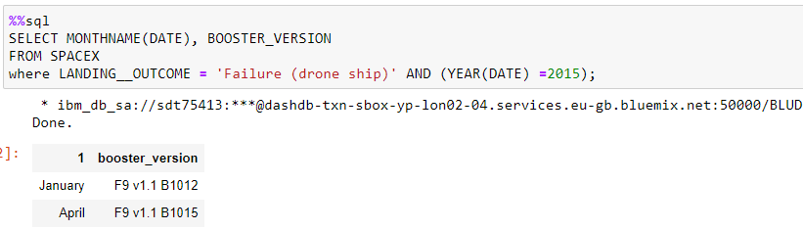
2015 Launch Records
In 2015, SpaceX had two failures to land on a drone ship.
Git Link: https://github.com/Trimorphous/IBM_Data_Sci_Final/blob/9e11b5333d28ba914475c6c421030861ebf28915/W2.1%20EDA%20exploratory%20data%20analysis%20with%20SQL.ipynb

Slide 27
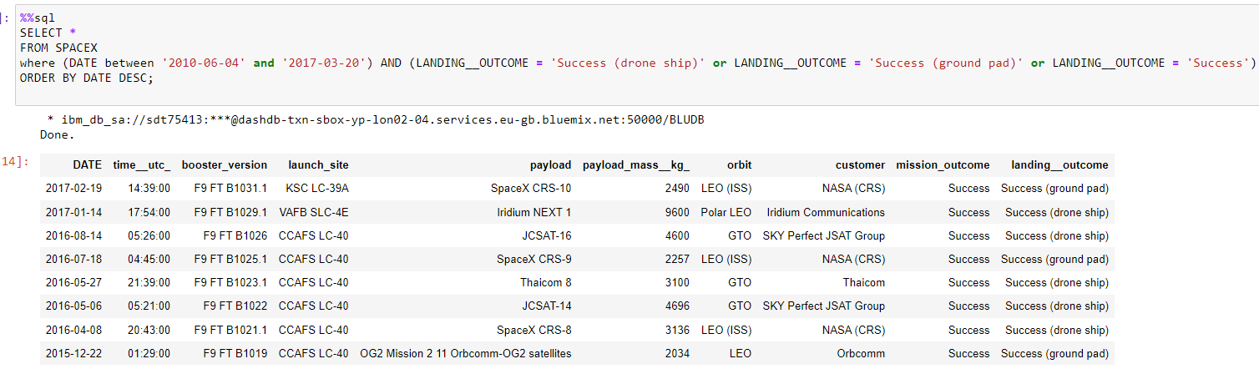
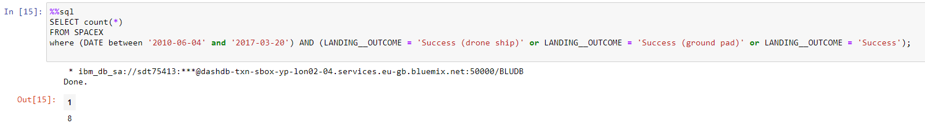
Rank Success Count Between 2010-06-04 and 2017-03-20
Successful landings between 2010-06-04 and 2017-03-20:
Count of Successful landings between 2010-06-04 and 2017-03-20:
Git Link: https://github.com/Trimorphous/IBM_Data_Sci_Final/blob/9e11b5333d28ba914475c6c421030861ebf28915/W2.1%20EDA%20exploratory%20data%20analysis%20with%20SQL.ipynb
Technical remark: I don’t understand the question. I can rank the landings, or I can count them. I can’t do both.
I’ll show both options. I hope that’s enough.
MK

Slide 28
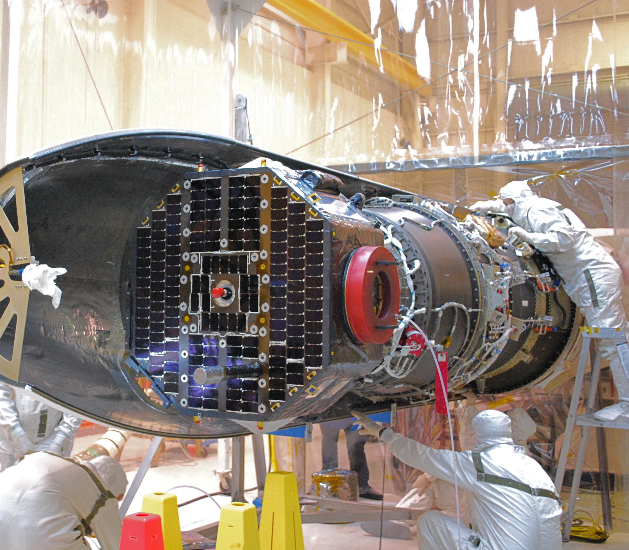
Interactive map with Folium
Analysis of launch sites use by SpaceX
Git Link (all maps are closed): https://github.com/Trimorphous/IBM_Data_Sci_Final/blob/3283a97caf9bd007358df56dc6a2b84ec7470268/W3.1%20Follium%20visualization.ipynb
IBM Cloud Link (has all maps already open and working):
https://eu-gb.dataplatform.cloud.ibm.com/analytics/notebooks/v2/9f339c2b-302e-4db2-9471-48583767b468/view?access_token=545c0a2a34b5154041a4d427d35df11ca7e41f5666e4e86c99dbfddfe0d9c253
Pegasus XL IBEX

Slide 29
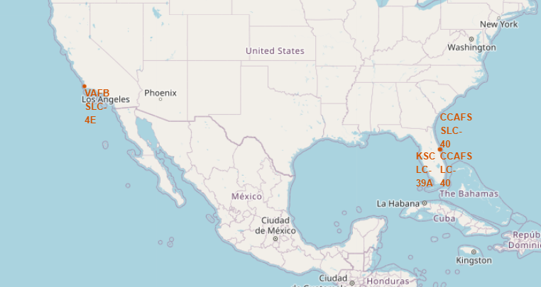
F9 Launch locations - Overview
F9 Boosters were used in four launch sites.
All sites are in the borders of the contiguous US.
The sites are grouped in two locations – Cape Canaveral, Florida, and Vandenberg Air Force Base, California.
Most likely, launches maneuver over the sea, so that Cape Canaveral launches maneuver east and enter into a prograde orbit, and Vandenberg AFB launches maneuver west and enter into a retrograde orbit.
Git Link: https://github.com/Trimorphous/IBM_Data_Sci_Final/blob/3283a97caf9bd007358df56dc6a2b84ec7470268/W3.1%20Follium%20visualization.ipynb

Slide 30
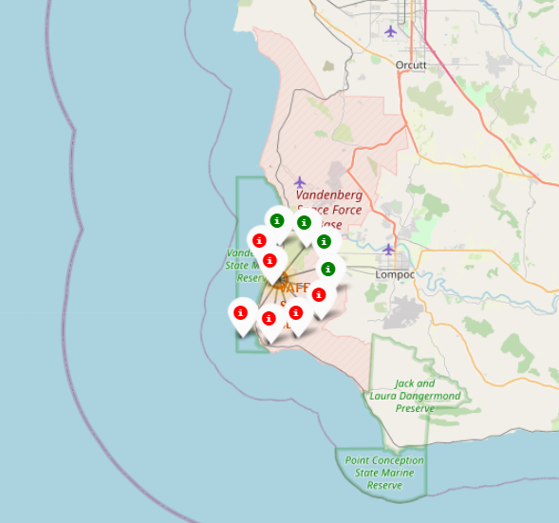
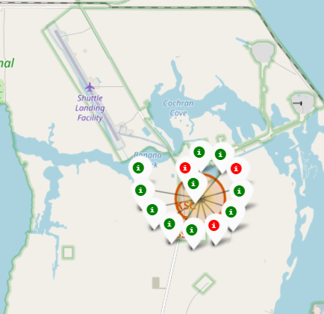
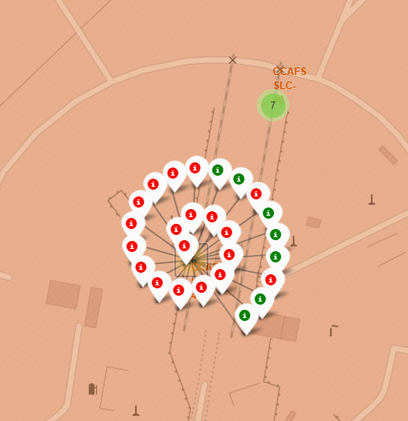
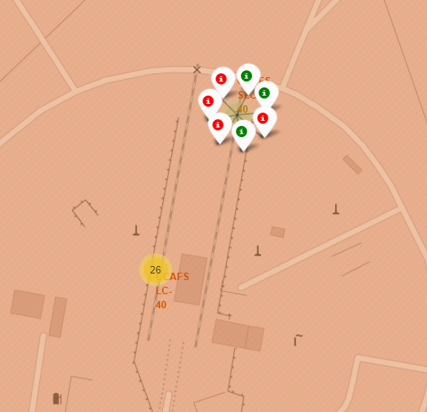
Mission Results per Launch-Site
Green markers represent successful missions.
Red markers represent unsuccessful missions.
VAFB SLC-4E
KSC LC-39A
CCAFS LC-40
CCAFS SLC-40
10 Launches
40% Success rate
13 Launches
77% Success rate
26 Launches
27% Success rate
7 Launches
43% Success rate
Launch sites with low success rates are usually sites where new technologies are first tested.
If SpaceX plans a launch for one of these low success rate sites, it is likely a new technology, and can suffer from a low success probability.
Git Link: https://github.com/Trimorphous/IBM_Data_Sci_Final/blob/3283a97caf9bd007358df56dc6a2b84ec7470268/W3.1%20Follium%20visualization.ipynb

Slide 31
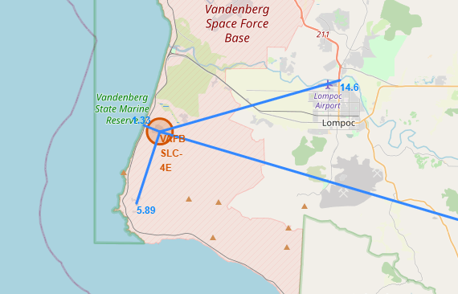
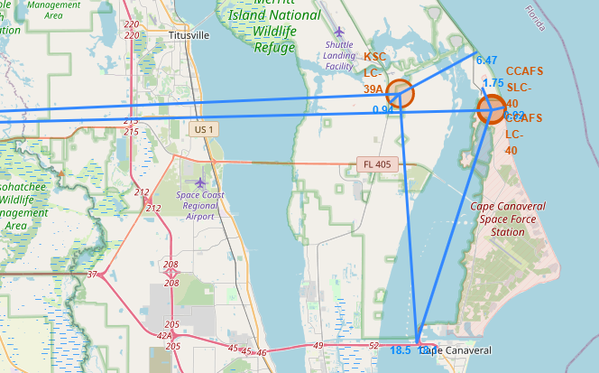
Analysis of Launch-Sites’ Proximities
West Coast: VAFB
East Coast: KSC, CCAFS
←Orlando, 75km
Santa Barbara, 87km →
Distances:
Railway Station: 5.89km
Highway: 14.6km
Ocean: 1.33km
Major City: 87km
KSC
Distances:
Railway Station: 0.94km
Highway: 18.5km
Ocean: 6.47km
Major City: 75km
CCAFS
Distances:
Railway Station: 1.75km
Highway: 18.1km
Ocean: 0.92km
Major City: 75km
Git Link: https://github.com/Trimorphous/IBM_Data_Sci_Final/blob/3283a97caf9bd007358df56dc6a2b84ec7470268/W3.1%20Follium%20visualization.ipynb
(Analysis in next slide)

Slide 32
Analysis of Launch-Sites’ Proximities
Conclusions:
A minimum distance of 75km is kept from the nearest major city. Possible reasons:
To minimize noise-polluting the city;
To minimize the chances of debris falling on the city in case of accident.
To minimize the chances of hazardous materials reaching the city in case of disaster.
All sites are close to the ocean. This is most likely to allow for free air-space for space-vehicles to maneuver without endangering people.
While all sites have highway access, the rail access is always significantly closer. Possible reasons:
To transport parts and complexes which are of unusual size.
To transport expensive equipment more safely.
To transport hazardous materials more safely.
To transport large quantities of supplies.
Git Link: https://github.com/Trimorphous/IBM_Data_Sci_Final/blob/3283a97caf9bd007358df56dc6a2b84ec7470268/W3.1%20Follium%20visualization.ipynb

Slide 33
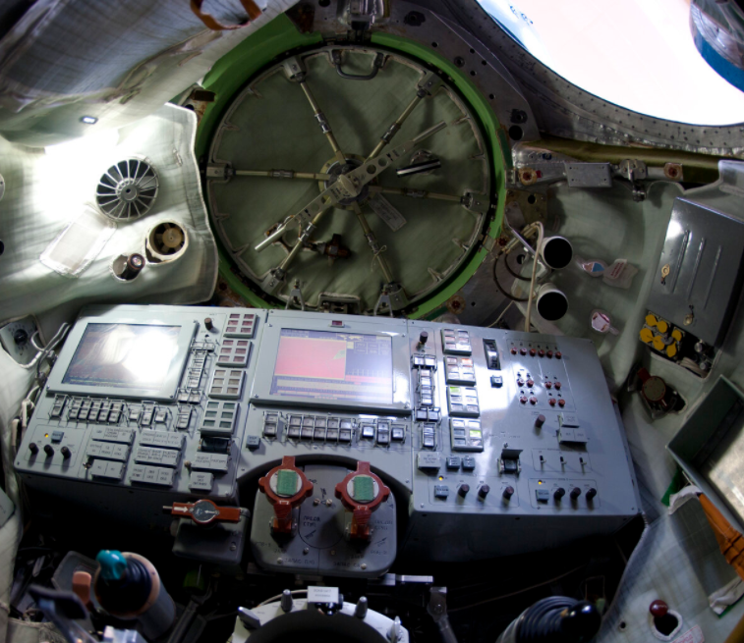
Dashboard with Plotly Dash
Python Code: https://github.com/Trimorphous/IBM_Data_Sci_Final/blob/main/spacex_dash_app.py
Data for Dash: https://github.com/Trimorphous/IBM_Data_Sci_Final/blob/2174f4a786f29eb9e3eae8fff1064b026848d9cd/spacex_launch_dash.csv
Soyuz TMA simulator

Slide 34
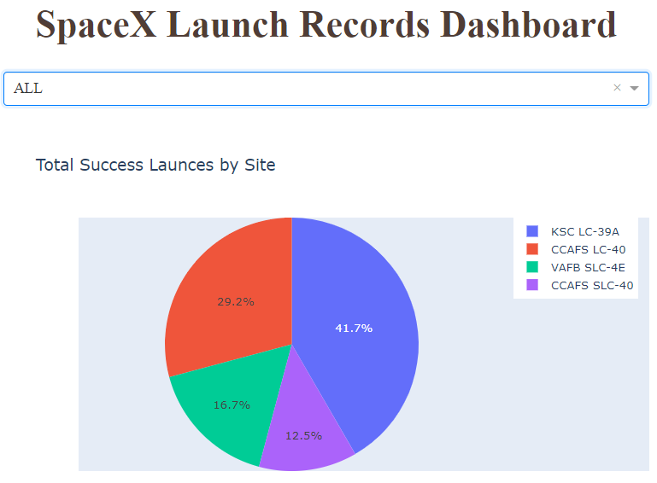
Distribution of Successful Launches Between Launch-Sites
The pie chart shows how the successful launches divide between the four sites.
The site from which the most successful launches were made is KSC LC-39A.
Python Code: https://github.com/Trimorphous/IBM_Data_Sci_Final/blob/main/spacex_dash_app.py

Slide 35
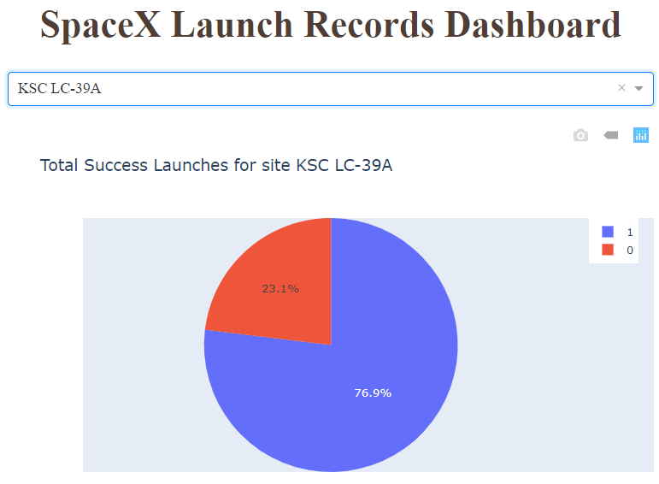
Site with Highest Success Rate
KSC LC-39A is also the site with the highest success ratio, with 76.9% successful launches.
Python Code: https://github.com/Trimorphous/IBM_Data_Sci_Final/blob/main/spacex_dash_app.py

Slide 36
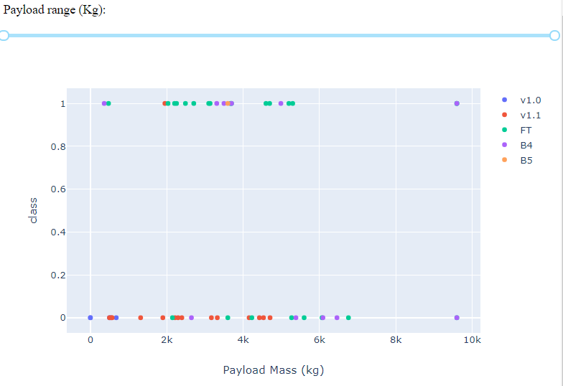
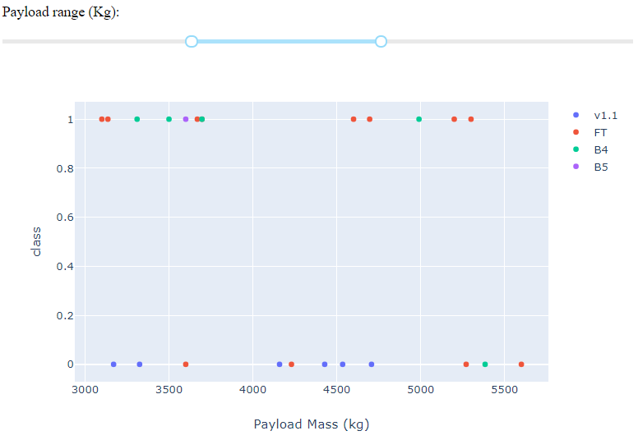
Payload Success Plots
Faliures happen at all payloads.
Success are most common at medium payloads
The F9-FT is the most reliable booster for mid-payload missions.
Python Code: https://github.com/Trimorphous/IBM_Data_Sci_Final/blob/main/spacex_dash_app.py

Slide 37
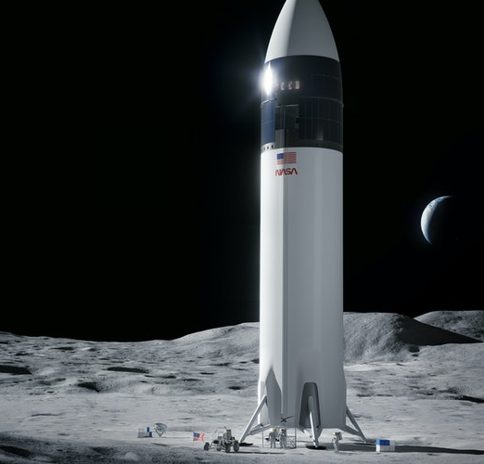
Predictive Analysis (Classification)
SpaceX concept of a lunar lander for the NASA Artemis program
Code: https://github.com/Trimorphous/IBM_Data_Sci_Final/blob/3d92f2004e620446cf4e436e618b3b98b8be29ef/W4.1%20Prediction.ipynb

Slide 38
Method
Machine learning models were constructed to predict the target variable ‘class’, indicating the landing outcome.
Model building was done using Scikitlearn library.
Four models were created:
Logistic Regression
Support Vector Machine
Decision Tree
K Nearest-Neighbors
Each model’s hyperparameters were optimized using Scikitlearn’s GridSearchCV (cross-validated grid search) with a 10-segment cross-validation.

Slide 39
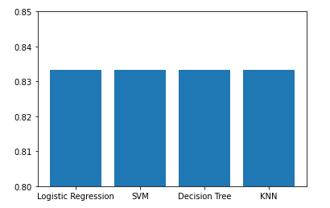
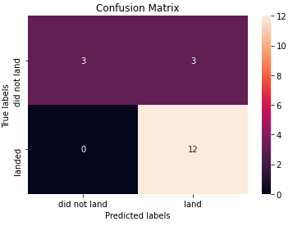
Classification Accuracy – Small Test Size
Performance of Different Models
With an initial, default value of 20% test sample size from the total available data, all four models perform equally accurately.
The confusion matrices for all models are identical, indicating that the same handful of samples are being mislabeled.
A larger test sample is required to differentiate between the models, so we repeat the analysis.
Accuracy

Slide 40
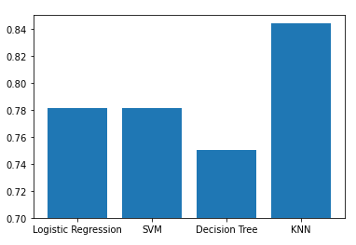
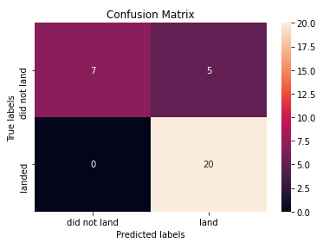
Classification Accuracy – Large Test Size
Performance of Different Models
Accuracy
Increasing the test size to 35% of the total available samples, KNN is shown to be the best performing model.
Plotting the confusion matrix, we see that, similarly to the small sample models, our model suffers from a high false-positives.
This is perhaps due to the relatively small number of crashed missions in our training set.
Confusion Matrix for KNN

Slide 41
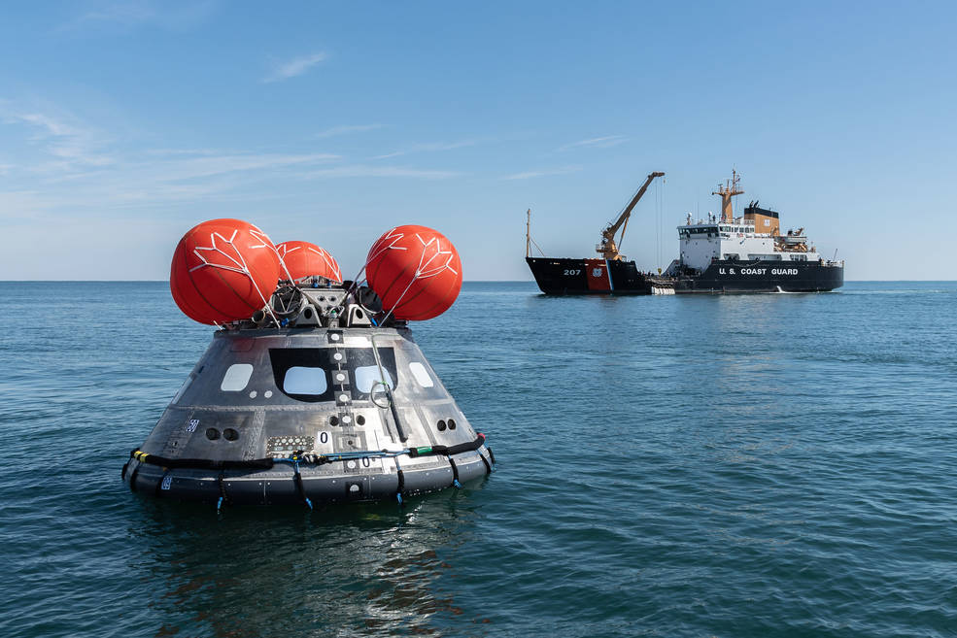
CONCLUSION
SpaceX increases it’s successful landing rate with time in all technologies and orbits.
Despite several past failures, they now have good success rates with tried-and-tested tech:
Midweight payloads
Home-based launches from Kennedy space center.
Low- and medium-altitude circular earth orbit.
They are still struggling with relatively new endeavors:
High energy orbits such as PO and GTO.
High Payloads
New booster versions
Remote base launches.
It is in those fields that conventional (non-reusable) rockets can still, for now, be competitive in the space transportation market.

